Slide 1
Your strong partner for trade and industry.
More than 50 years of expertise.

Slide 2
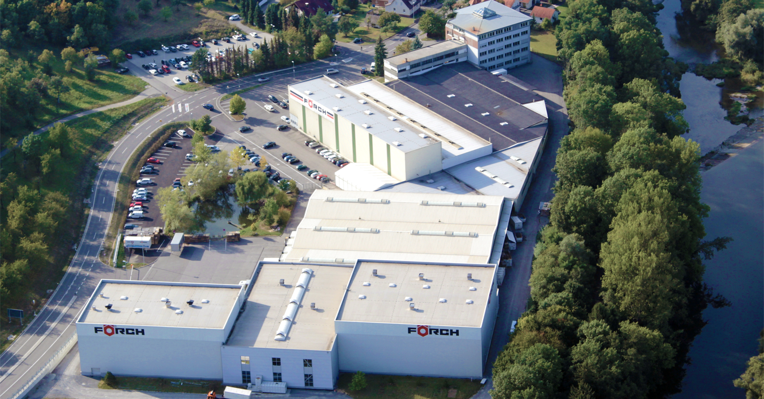
Headquarters in Neuenstadt-Kochertürn, Germany
The Company

Slide 3
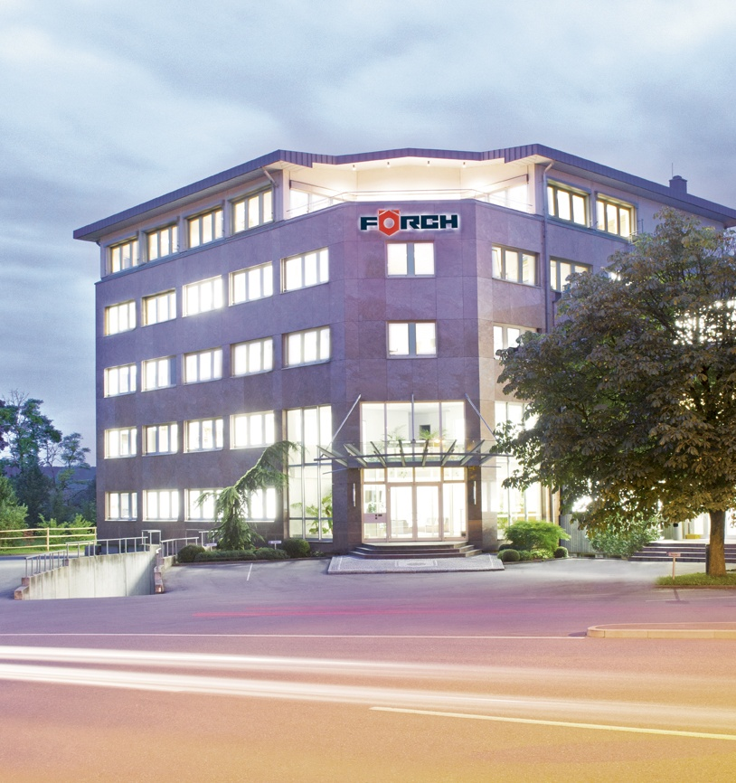
FÖRCH at a glance.
The Company
Founded in 1963
Group turnover 340 million Euros
therefrom 195 million Euros in Germany
More than 2.600 employees
therefrom 1.600 in the direct sales
18 international companies
25 branch offices in Germany
About 80.000 articles
Approx. 1.200 active suppliers with
central sourcing

Slide 4
Customer Target Groups.
The Company
Automotive Trade
Car dealerships Trucks / commercial vehicles Repair Body construction companies Bikes
Building Trade
Woodwork Construction industry Building services/Housing technology Electrical industry

Slide 5
Customer Target Groups.
The Company
Metal Trade
Steel and metal construction Locksmith‘s shops
Industrial and Maintenance Workshops
Maintenance Assembly production

Slide 6
Breakdown by Customer Target Groups.
The Company
Share or turnover in the Group
more than 300.000 active customers
Share of turnover in Germany
more than 150.000 active customers

Slide 7
FÖRCH Group.

Slide 8
Focused on Europe.
FÖRCH Group
1963 | Germany
1977 | Austria
1991 | Italy Denmark
1999 | France Poland
2000 | Croatia
2002 | The Netherlands
2006 | Hungary Switzerland Czech Republic Slovakia Slovenia
2007 | Luxembourg Spain Portugal
2008 | Romania
2012 | Turkey
Foreign companies
Distributors
11.03.2015

Slide 9
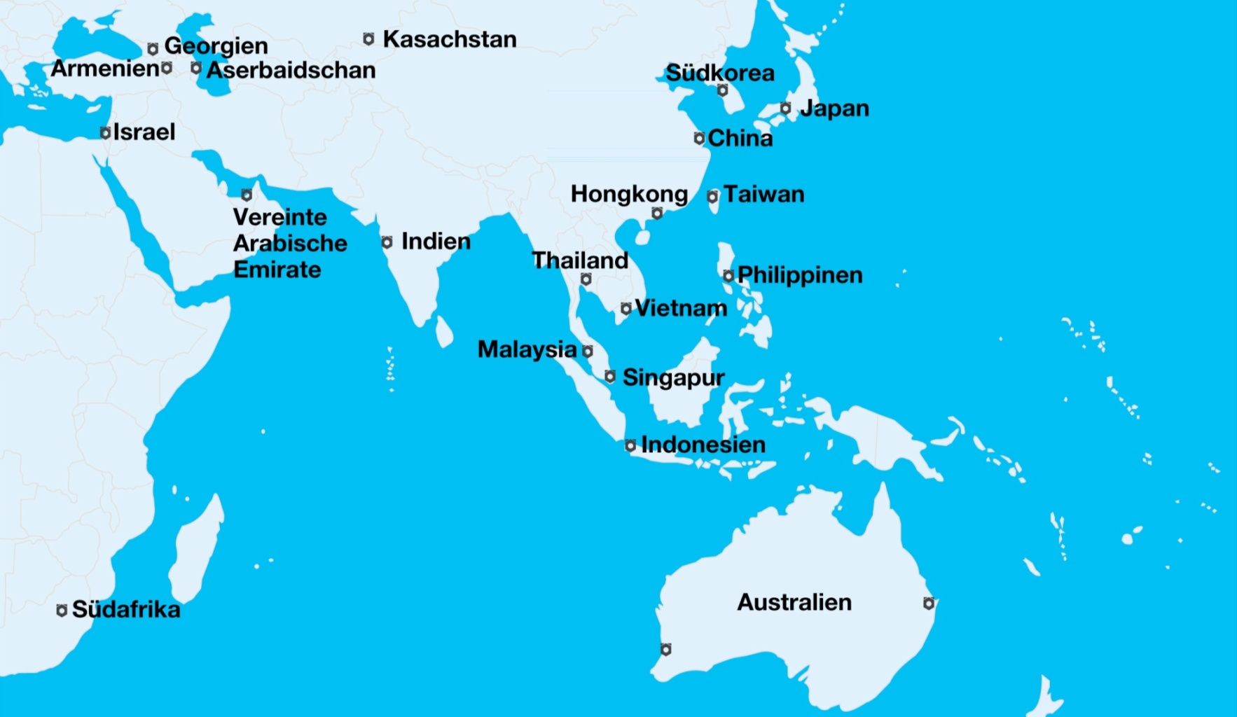
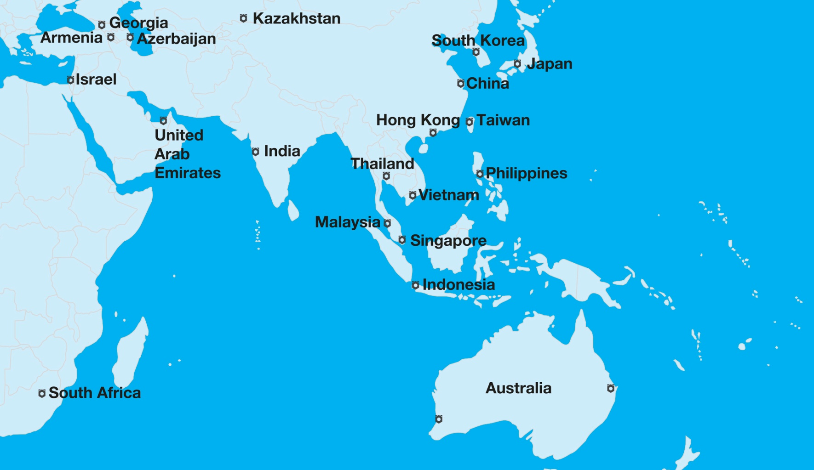
Internationally successful.
FÖRCH Group
11.03.2015

Slide 10
Key Figures - Group.

Slide 11
Turnover Development.
Key Figures - Group
Turnover in million €

Slide 12
Employee Development.
Key Figures - Group
Number of employees
Employees planned
.
.

Slide 13
Marketing Channels.

Slide 14
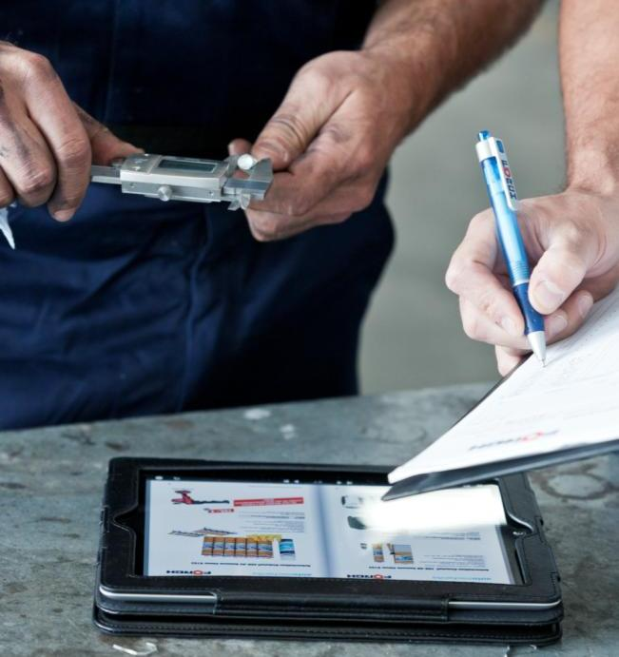
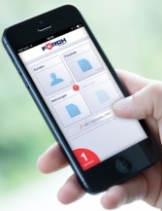
FÖRCH Direct Sales.
Marketing Channels
Customer Requirements:
High service degree: > 98,5 %
delivery of goods in Germany within 24 hours when order is sent until 5:30 p.m.
Sales Rep. Equipment: 2-Device-Strategy
iPad
Collection
Order entry
iPhone
Communication
Price list
24/7 Online

Slide 15
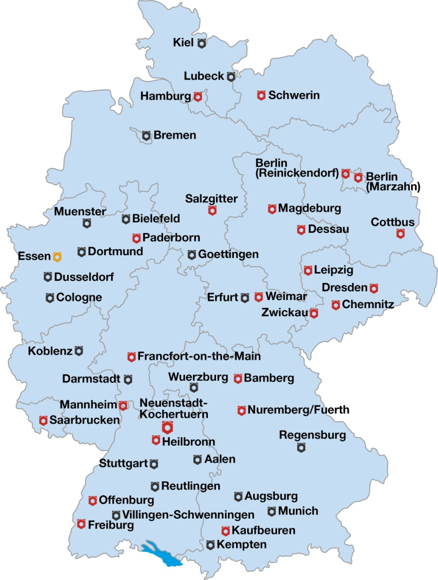
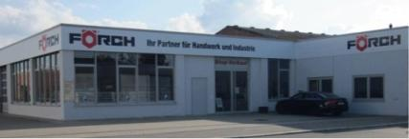
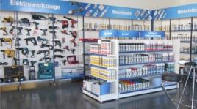
25 FÖRCH Sales Offices in Germany.
Marketing Channels
Back office for regional
customer service
Customized product selection
Several thousands of articles available on site
For covering immediate needs
Locations for trainings and meetings of the
Field Service
In-House Exhibitions
Sales Offices
Planned Sales Offices
Projected Sales Offices

Slide 16
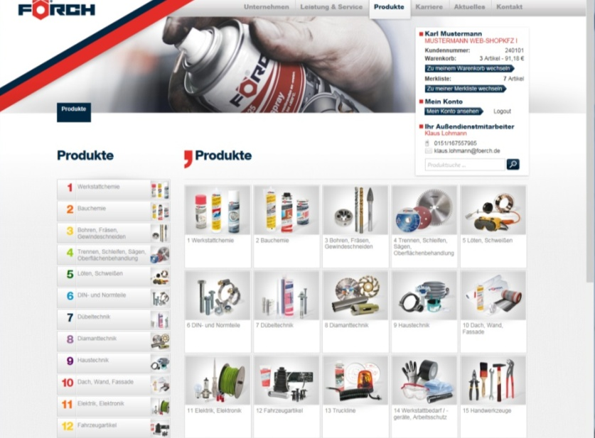
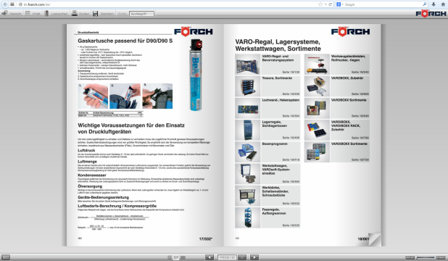
E-Commerce.
Marketing Channels
FÖRCH website:
Simplified product search
Intelligent searching
List with suggestions with photo
Direct entry of article no. or article group
Filtering acc. to product groups
Online-Browsing Catalogue
All 80.000 articles online available
Recently viewed products
Wish list function
Check for foerch.com or foerch.de

Slide 17
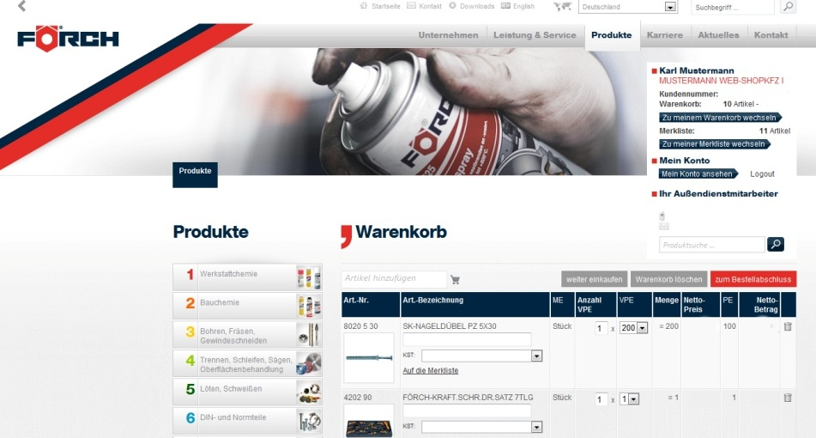
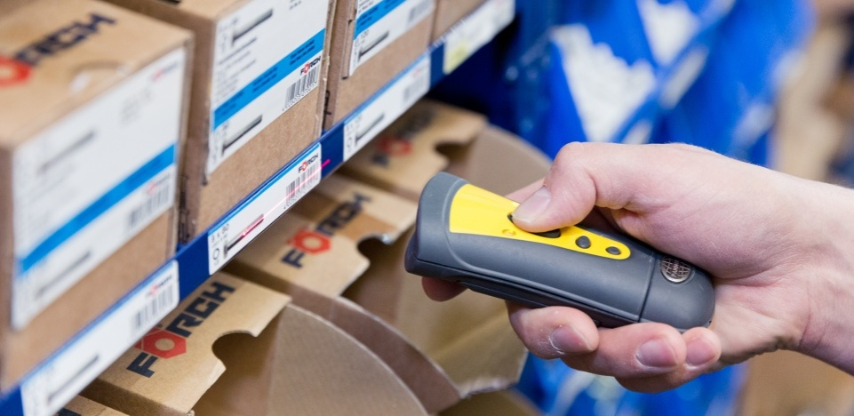
E-Commerce.
Marketing Channels
FÖRCH web-shop: Additional functions after registration:
Customised individual prices and pre-defined packaging units
Delivery address administration
Order templates
User administration / permission workflow
Approval workflow
Tool and cost center management
Scanner based processing

Slide 18
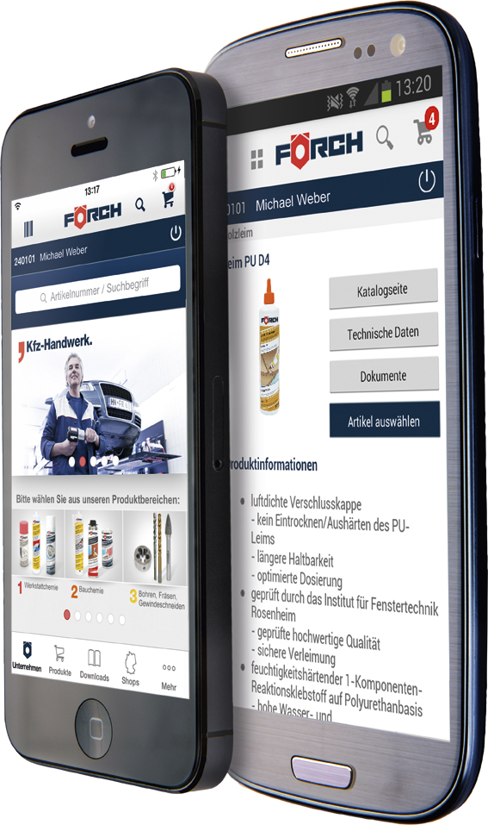
E-Commerce.
Marketing Channels
FÖRCH Customer App:
Simplified mobile access
Functions as at the web-shop
All 80.000 articles online available
Available for iOS (iPhone/iPad), as well as for
android smartphones

Slide 19
E-Commerce.
Marketing Channels
FÖRCH E-Procurement:
Customised individual data processing and solutions
Electronic product catalogues for different E-procurement systems
of the FÖRCH customers acc. to standards like e.g. BMEcat, Datanorm,
and others. Classification acc. to ecl@ss, UNSPSC, Etim
Interfaces e.g OCI to SAP

Slide 20
Phone Sales.
Marketing Channels
Professional, selective service over the phone by especially trained employees
Ensuring continuous support for all customers in representation cases
Acquisition, advisory service and sales contracts

Slide 21
Key Figures - Germany.

Slide 22
Turnover Development.
Key Figures - Germany
Turnover in million €

Slide 23
Employee Development.
Key Figures - Germany
Number of Employees
.
.

Slide 24
Logistics / Distribution

Slide 25
FÖRCH Direct-Delivery (Distributive Concept).
Logistics / Distribution
Delivery into 50 countries from Neuenstadt, Germany
17 countries thereof in Europe as third-party-delivery directly to the customer
Delivery of goods within 24 to 72 hours
Advantages:
Access to the complete FÖRCH product range
All available package sizes
All sales systems
Consistent product quality
Delivery quota > 98,5 %
Lower capital commitment
Lower exchange rate risk

Slide 26
FÖRCH Direct-Delivery (Distributive Concept).
Logistics / Distribution
Consignment stock on site

Slide 27
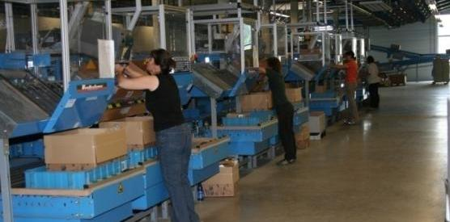
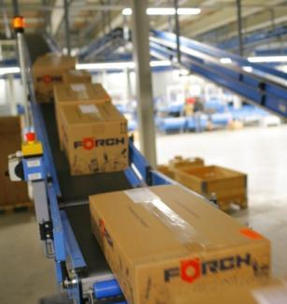
Core Competence - Logistics.
Logistics / Distribution
The workflow resp. the processes starting with material reception, the pre-storage and the logistic center are matched and optimised to the smallest detail. Reliable logistic partners ensure that orders are supplied within 24 to 48 hours all over Germany.
Delivery quota > 98,5 %
Certified acc. to DIN EN ISO 9001:2008 Quality Management
Certified acc. to DIN EN ISO 14001:2009 Environmental Management

Slide 28
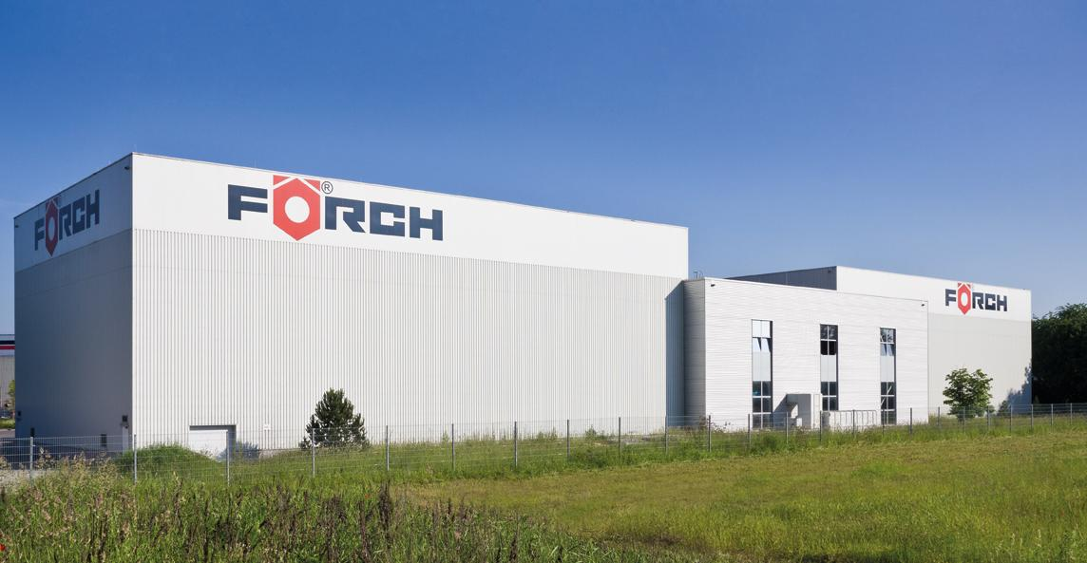
Logistics Center.
Logistics / Distribution

Slide 29
Logistics Center.
Logistics / Distribution
Implementing of the Logistic Center in 2006 with system components
„Goods to person“
„Pick by/to Light“
„Pick & Pack“
Size of Building (LxWxH): 100 m x 50 m x 16 m
Conveyor Distance: 1.800 m
Storage of
> 70.000 different articles
100.000 package units

Slide 30
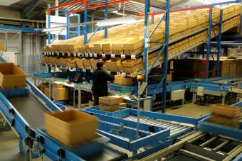
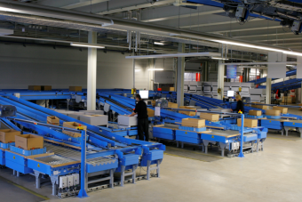
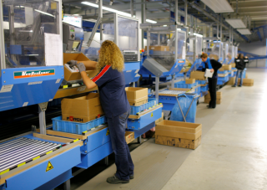
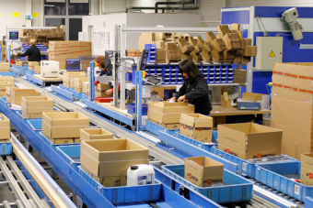
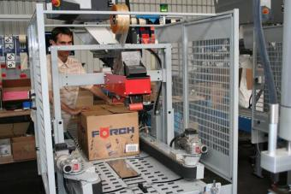
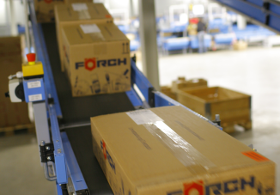
Handling Operations of an Order.
Logistics / Distribution
1. Start of Order
2. Commissioning V-sector resp. Commissioning K-sector
3. Quality Control / Reworking
4. Packaging 5. Dispatch

Slide 31
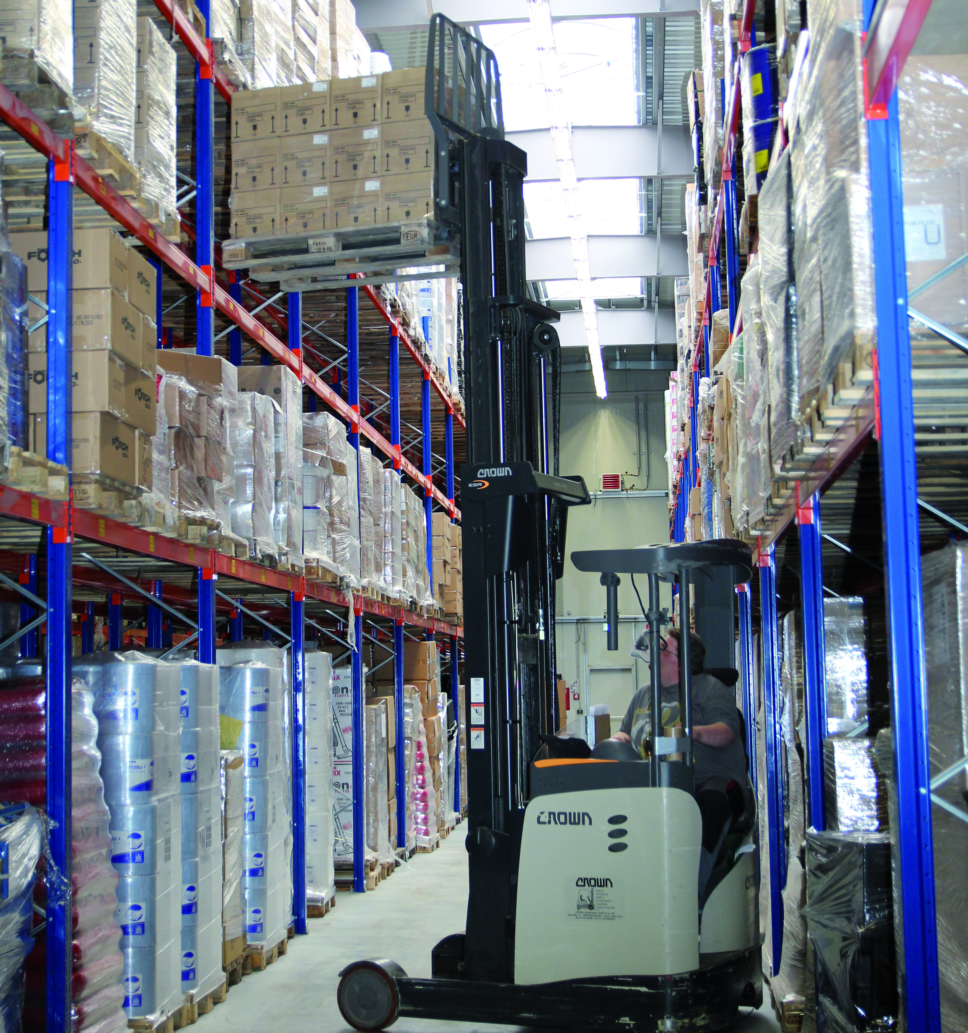
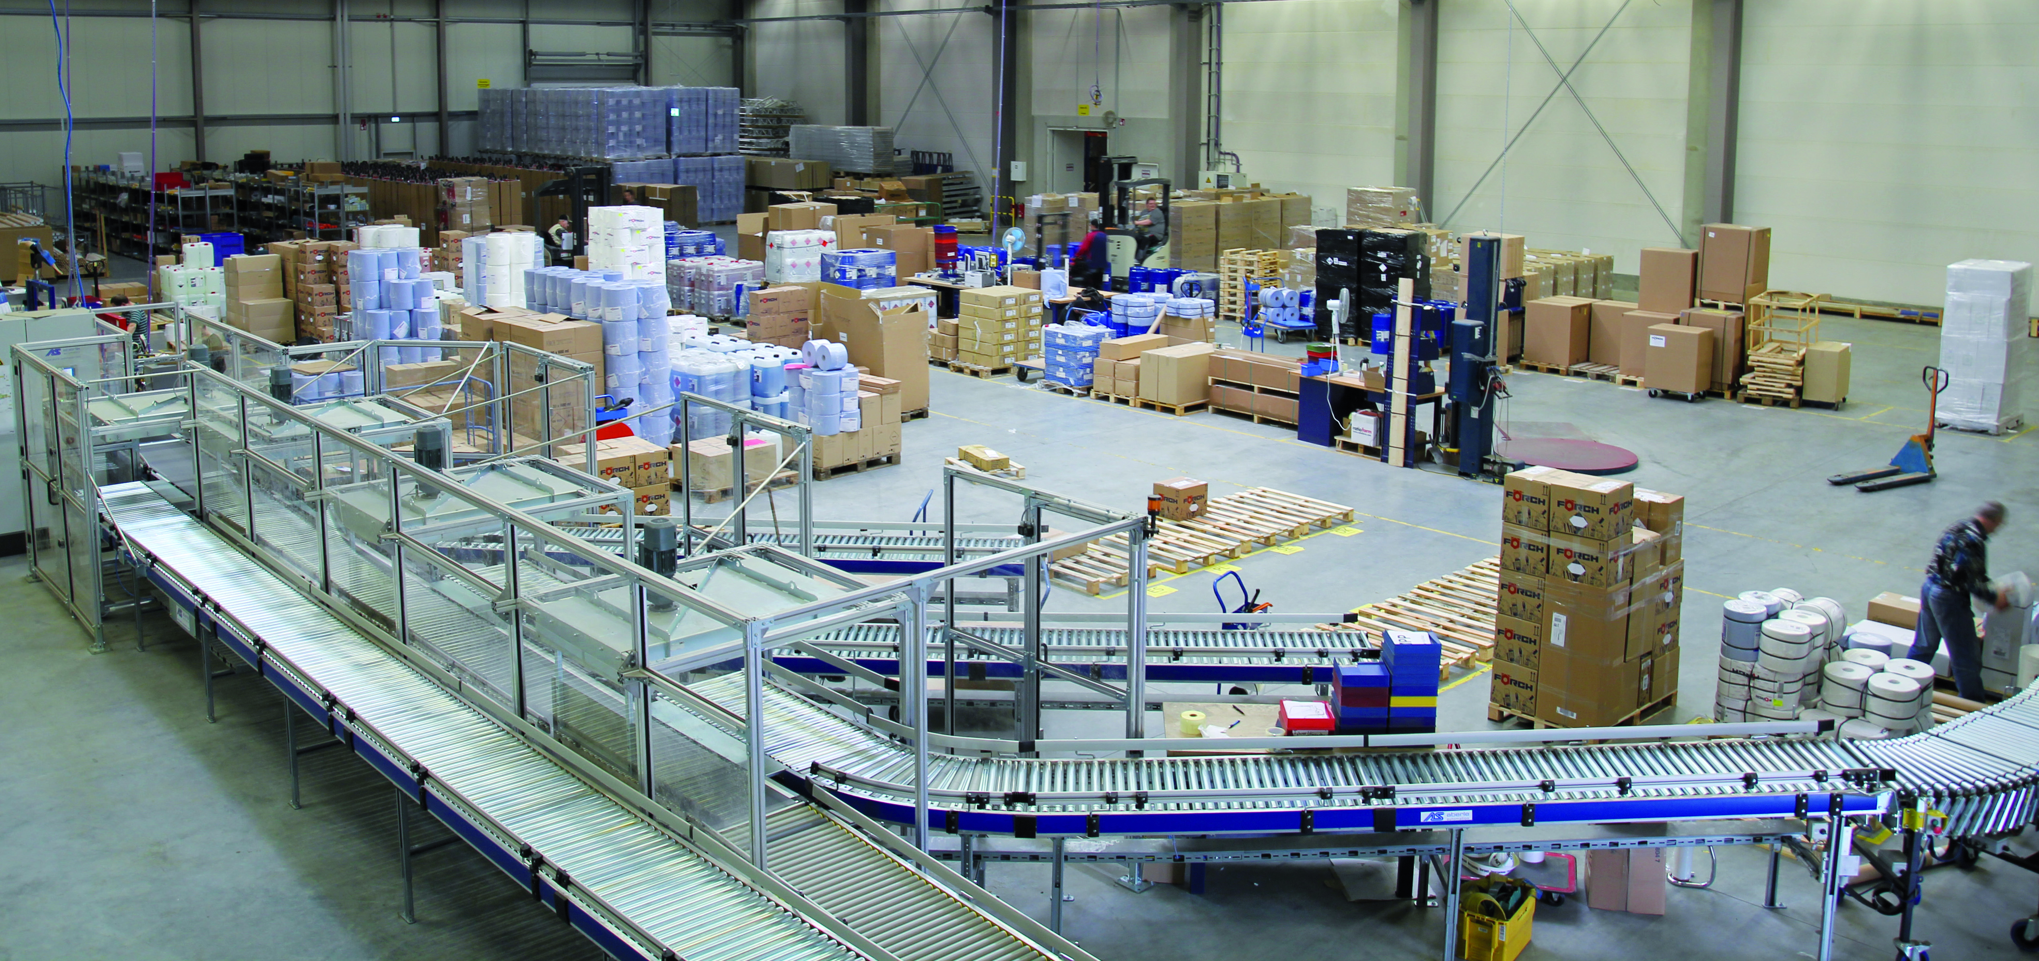
Logistics / Distribution
Simultaneously operated warehouses
in Neuenstadt-Stein.

Slide 32
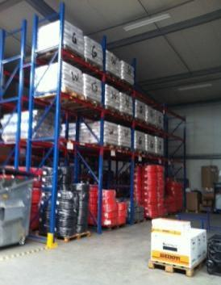
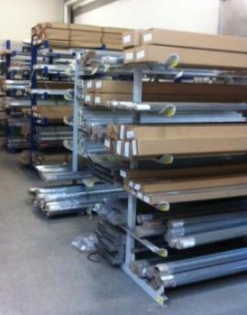
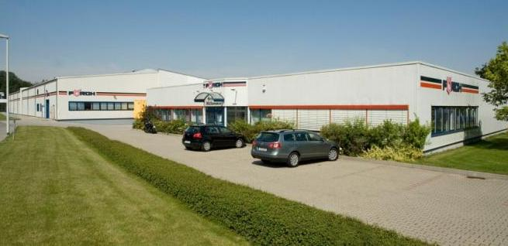
Logistics / Distribution
Simultaneously operated warehouses
Zwickau – built in 2000.
For approx. 800 bulky articles with
key aspect on building trade with the
sectors pipe insulation, roof interlayers,
assembly rails and on automotive trade
with workshop presses and cranes
300 packages / day
70 transport orders / day
> 1.300 pallet pre-storage places
300 m² area for bulk goods
Cantilever shelves with > 100 places
3 ramps

Slide 33
Trade Fairs

Slide 34
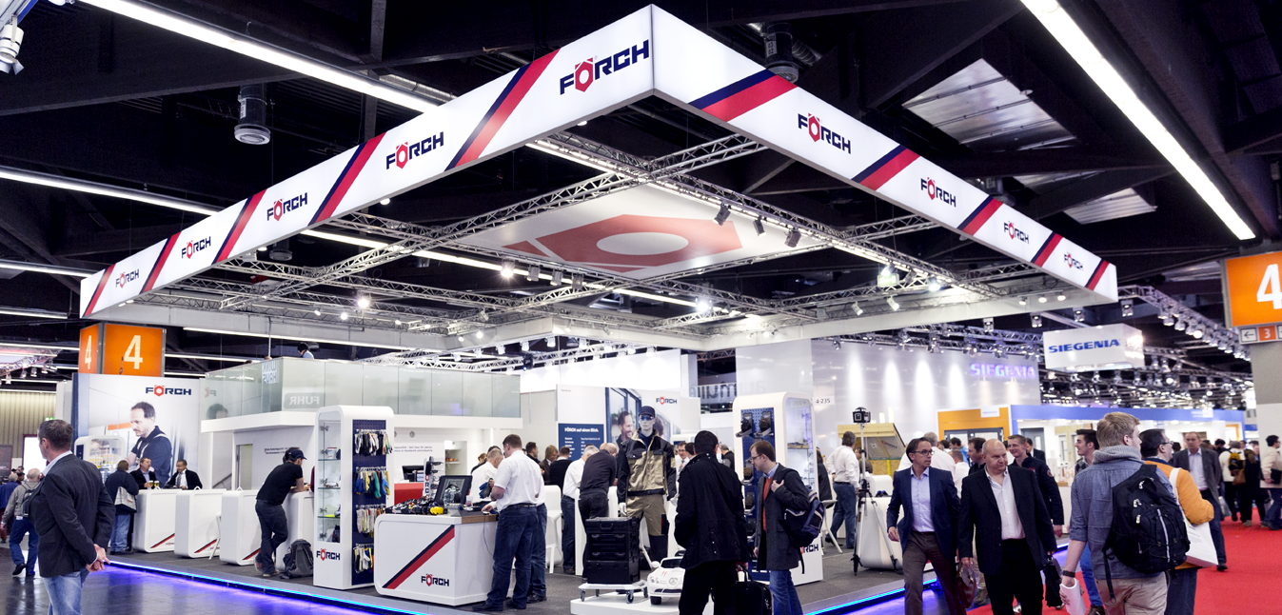
FÖRCH – be in touch.
Trade Fairs
Nationwide – Visit us at the Important Trade Shows of our Industrial Branch

Slide 35
Schedule of Exhibitions 2015.
Trade Fairs
Mon. 19.01., till Sat. 24.01.2015
Munich
Fri. 17.04., till Sun. 19.04.2015
Schkeuditz / Leipzig
Sat. 20.06., till Sun. 21.06.2015
Heilbronn
Wed. 09.09., till Sun. 13.09.2015
Neumünster
Fri. 20.11. and Sun. 22.11.2015
iNNOCenter Neuenstadt

Slide 36
International Exhibitions 2015.
Trade Fairs
Wed. 21.01., till Sat. 24.01.2015
Salzburg/Austria
Tue. 13.10., till Sat. 17.10.2015
Paris/France
Thu. 15.10., till Sat. 17.10.2015
Gorinchem/Netherlands
Tue. 17.11., till Sat. 21.11.2015
Lyon/France

Slide 37
FÖRCH iNNOCenter.

Slide 38
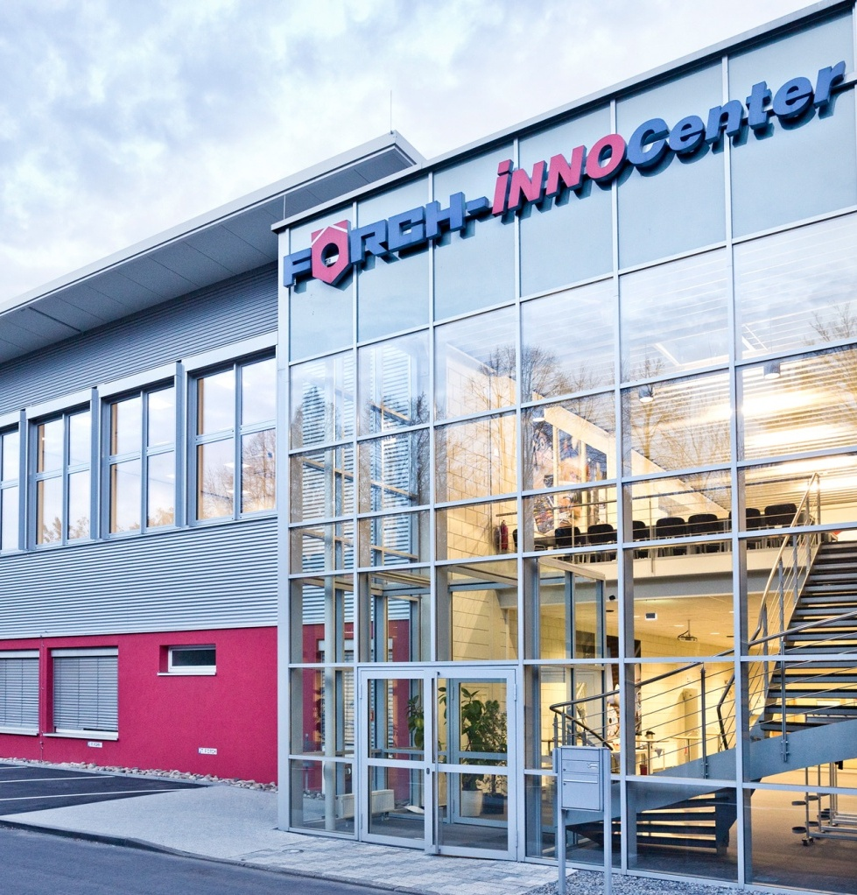
FÖRCH iNNOCenter.
FÖRCH iNNOCenter
Qualification and training centre for
customers and employees
More than 1.000 m² exhibition and
training area
Conference centers for up to 200
people
Location for In-house exhibitions
Catering service possible
Offices and storage rooms

Slide 39
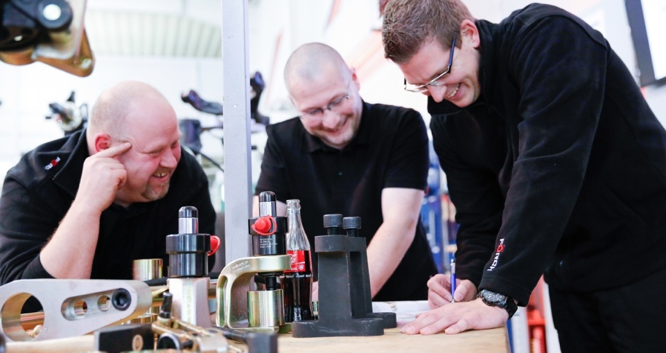
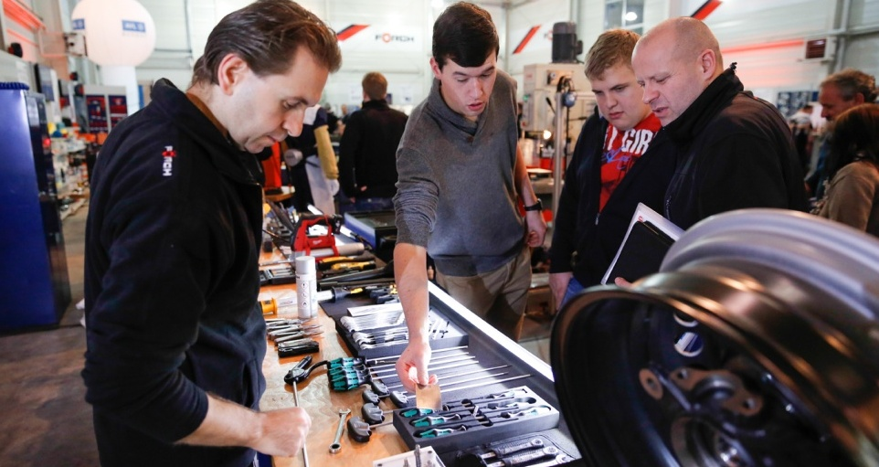
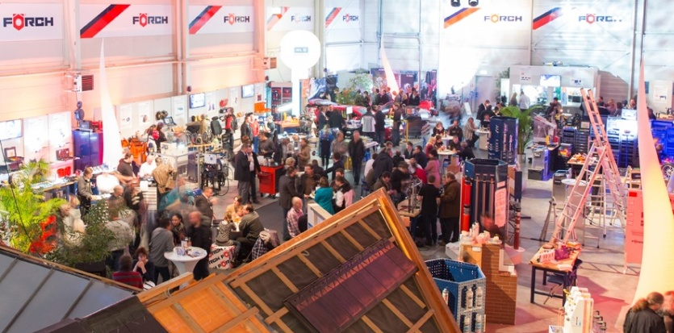
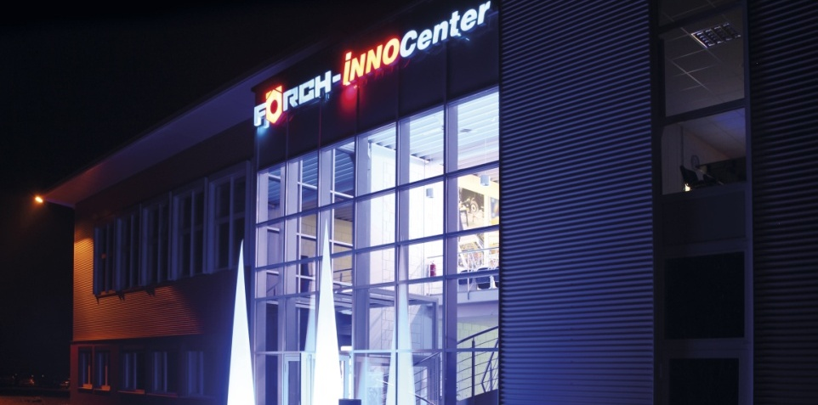
FÖRCH iNNOCenter
In-House Exhibitions and Trainings.

Slide 40
The Brand FÖRCH.

Slide 41
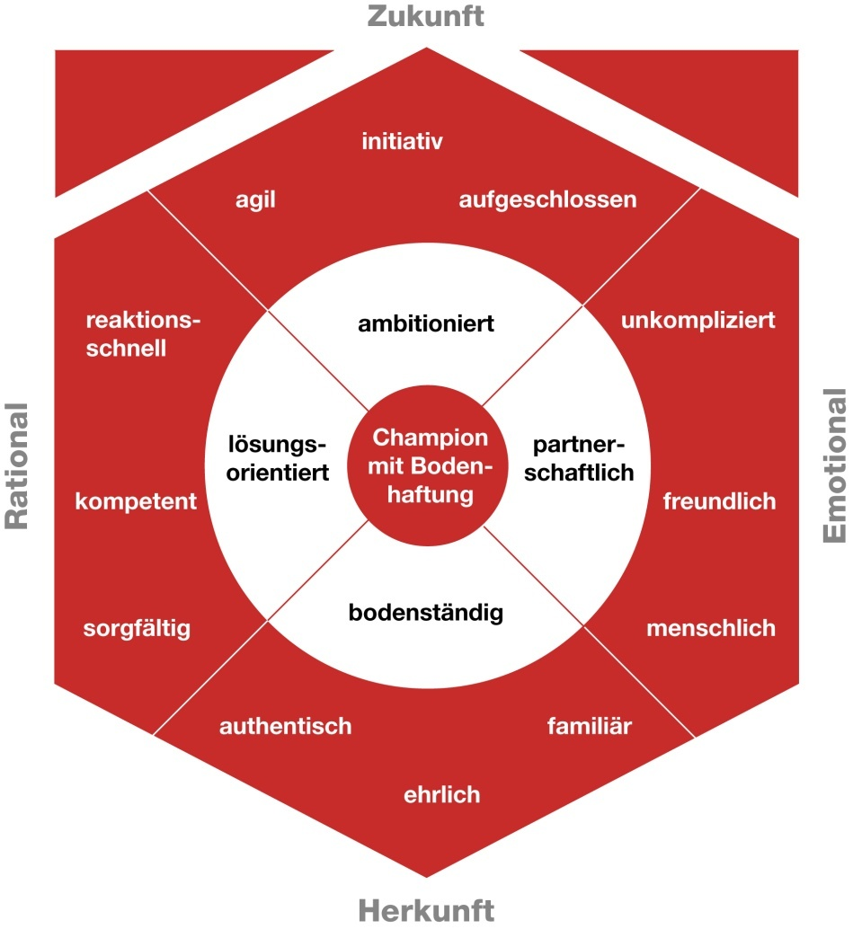
Our Brand Value Model.
The Brand FÖRCH
With ambition
Never be satisfied with the results. Always set new aims. Whatever we do, we do it right.
As partners
We all pull into one direction. We help ourselves – and our customers. We always have an open ear for our customers and colleagues.
Solution-orientated
We reflect with the customer, understand HIS problem and solve it. We chose the simple, non-complicated way. ‘Cannot be done’, does not exist.
Down-to-earth
We know where we come from. We know to whom we owe our success. We are a family-owned company – and one big family. Success does not make us big-headed.

Slide 42
The FÖRCH mission.
The Brand FÖRCH
FÖRCH is THE systemic partner for trade and industry. Its success results from being close to the customers while being focused on quality, service and innovation.
Partnership.
FÖRCH stands for a reliable communication.
It’s by competence and professional attitude that
FÖRCH inspires its customers. For FÖRCH
the focus is on people.
Quality.
FÖRCH stands for high quality in all
business sectors. FÖRCH
supplies high-quality products.
Service.
FÖRCH adjusts all processes
optimally to the customers‘ needs.
Innovation.
FÖRCH generates additional
values by continuous
reflection and renewal of the
existing products, services
and procedures.
Security.
FÖRCH acts sustainably and economically. FÖRCH ensures reliability and thus creates trust.

Slide 43
Clienting.

Slide 44
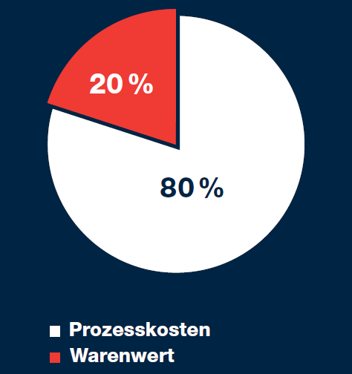
C-Parts-Management.
Clienting
Characteristics of C-Parts
Low merchandise value
High number of different articles
Necessary for the regular course of business
No reasonable ratio of merchandise value and procurement effort
Results from C-Parts-Management
Individual article combination out of a broad C-parts range
Continuously high quality of the articles
Fast and reliable deliveries
Constant coverage of the basic needs
Effective contribution to process cost optimising

Slide 45
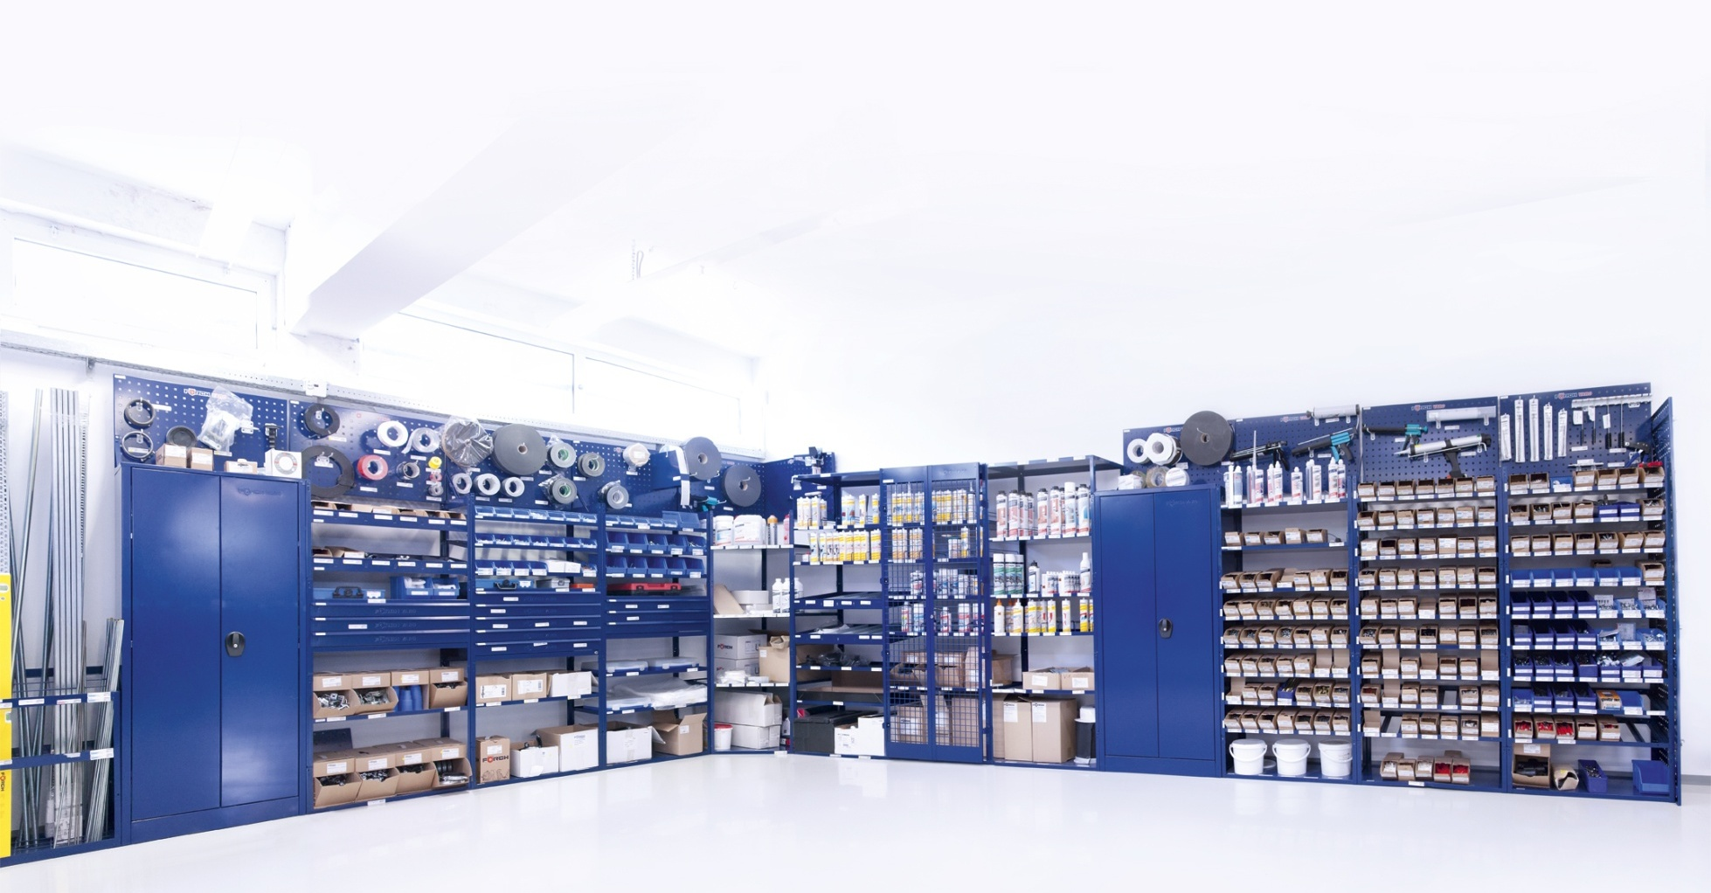
FÖRCH VARO VARiable Order System
Clienting

Slide 46
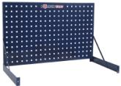
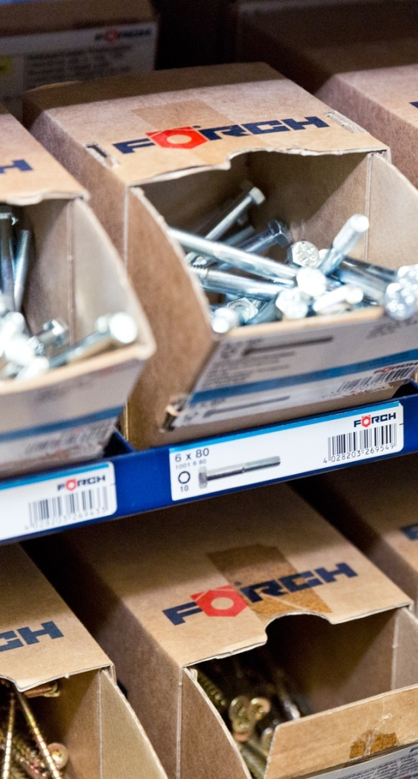
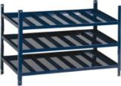
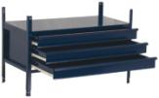
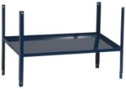
FÖRCH VARO shelf system.
Clienting
Clear Stocking due to
Individual modules for the different product groups
Standardized labelling of the storage places
Optimum Space Utilisation
Individual and space-saving assembly in your workshop
Modules are adjusted to package sizes
Easy to expand
Favourable Rent
No financing costs

Slide 47
FÖRCH Racing.

Slide 48
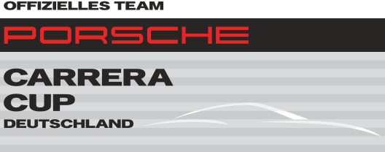
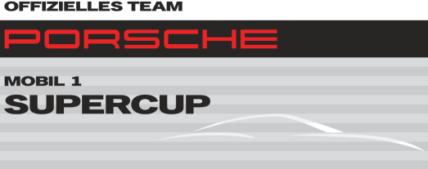
FÖRCH Racing.
FÖRCH Racing
Since 2010 additionally Official team at the Porsche Carrera Cup Deutschland
Since 2012 Official Team at the Porsche Mobil 1 Supercup
2014 again represented in both Porsche Brand Cups

Slide 49
Product Programme.

Slide 50
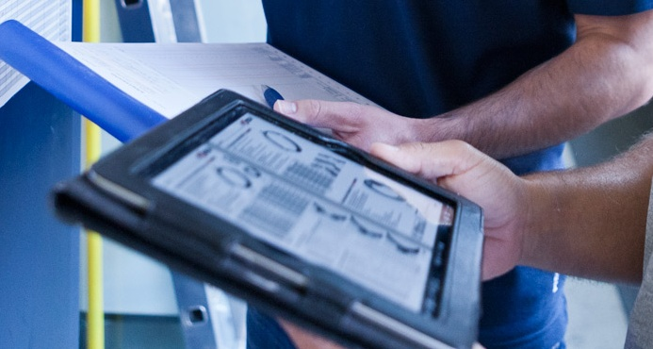
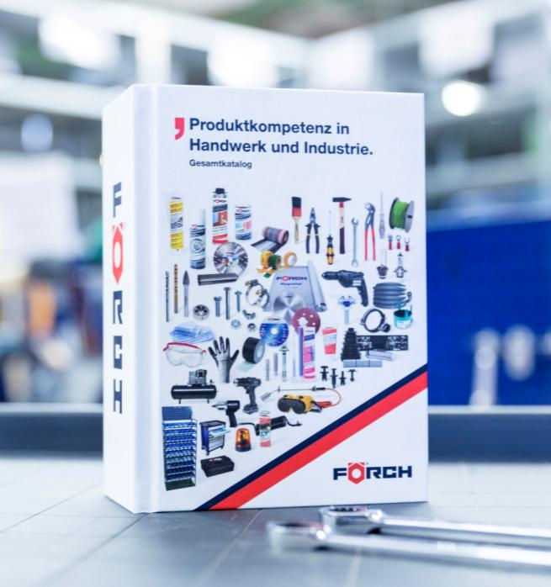
Approx. 80.000 articles available digitally and in printed version.
Product Programme

Slide 51
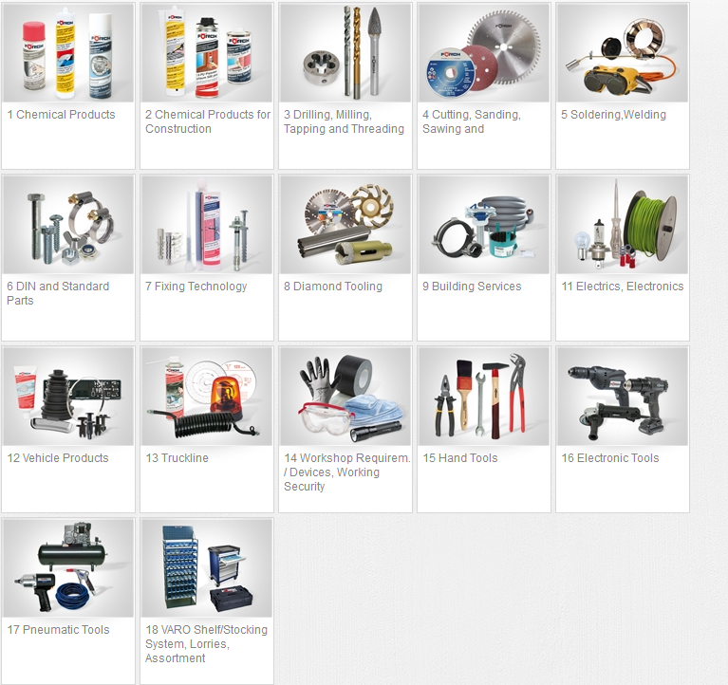
General overview of the 18 chapters.
Product Programme

Slide 52
Thank you very much for your attention.
Theo Förch GmbH & Co. KG
Theo-Förch-Straße 11-15
D-74196 Neuenstadt
Germany
info@foerch.de
foerch.com

