Slide 2
Who we are – what we do

Slide 3
Company history and business description

Slide 4
Facts and numbers (w/o Kuhn Gruppe)

Slide 5
Facts (w/o Kuhn Gruppe)

Slide 6
Who we are

Slide 7
R&D - knowledge Pool and Think Tank

Slide 8
svt holding – quality management

Slide 9
Passive / preventive fire protection

Slide 10
PYRO-SAFE ® Fire Protection Products

Slide 11
PYRO-SAFE ® Fire Protection Products

Slide 12
PYRO-SAFE ® Fire Protection Products

Slide 13
svt fire penetration seal systems

Slide 14
svt fire penetration seal systems

Slide 15
svt PYRO-SAFE ® CT

Slide 16
svt PYRO-SAFE ® CT

Slide 17
svt PYRO-SAFE ® CT – Fire Test

Slide 18
svt PYRO-SAFE ® CT – Fire Test

Slide 19
svt PYRO-SAFE ® CT – Fire Test

Slide 20
svt PYRO-SAFE ® CT

Slide 22
svt PYRO-SAFE ® CT ML

Slide 23
svt PYRO-SAFE ® CT ML

Slide 24
svt PYRO-SAFE ® CT ML

Slide 25
svt cable protection system

Slide 26
svt PYRO-SAFE ® cable protection

Slide 27
svt PYRO-SAFE ® cable protection

Slide 28
svt PYRO-SAFE ® cable protection

Slide 29
Advantages of PYRO-SAFE Cable Coating

Slide 30
svt PYRO-SAFE ® Flammotect-A

Slide 31
svt PYRO-SAFE ® Flammotect-A

Slide 32
svt PYRO-SAFE ® Flammotect-A

Slide 33
svt PYRO-SAFE ® cable bandage system

Slide 34
svt PYRO-SAFE ® cable bandage system

Slide 35
svt PYRO-SAFE ® DG

Slide 36
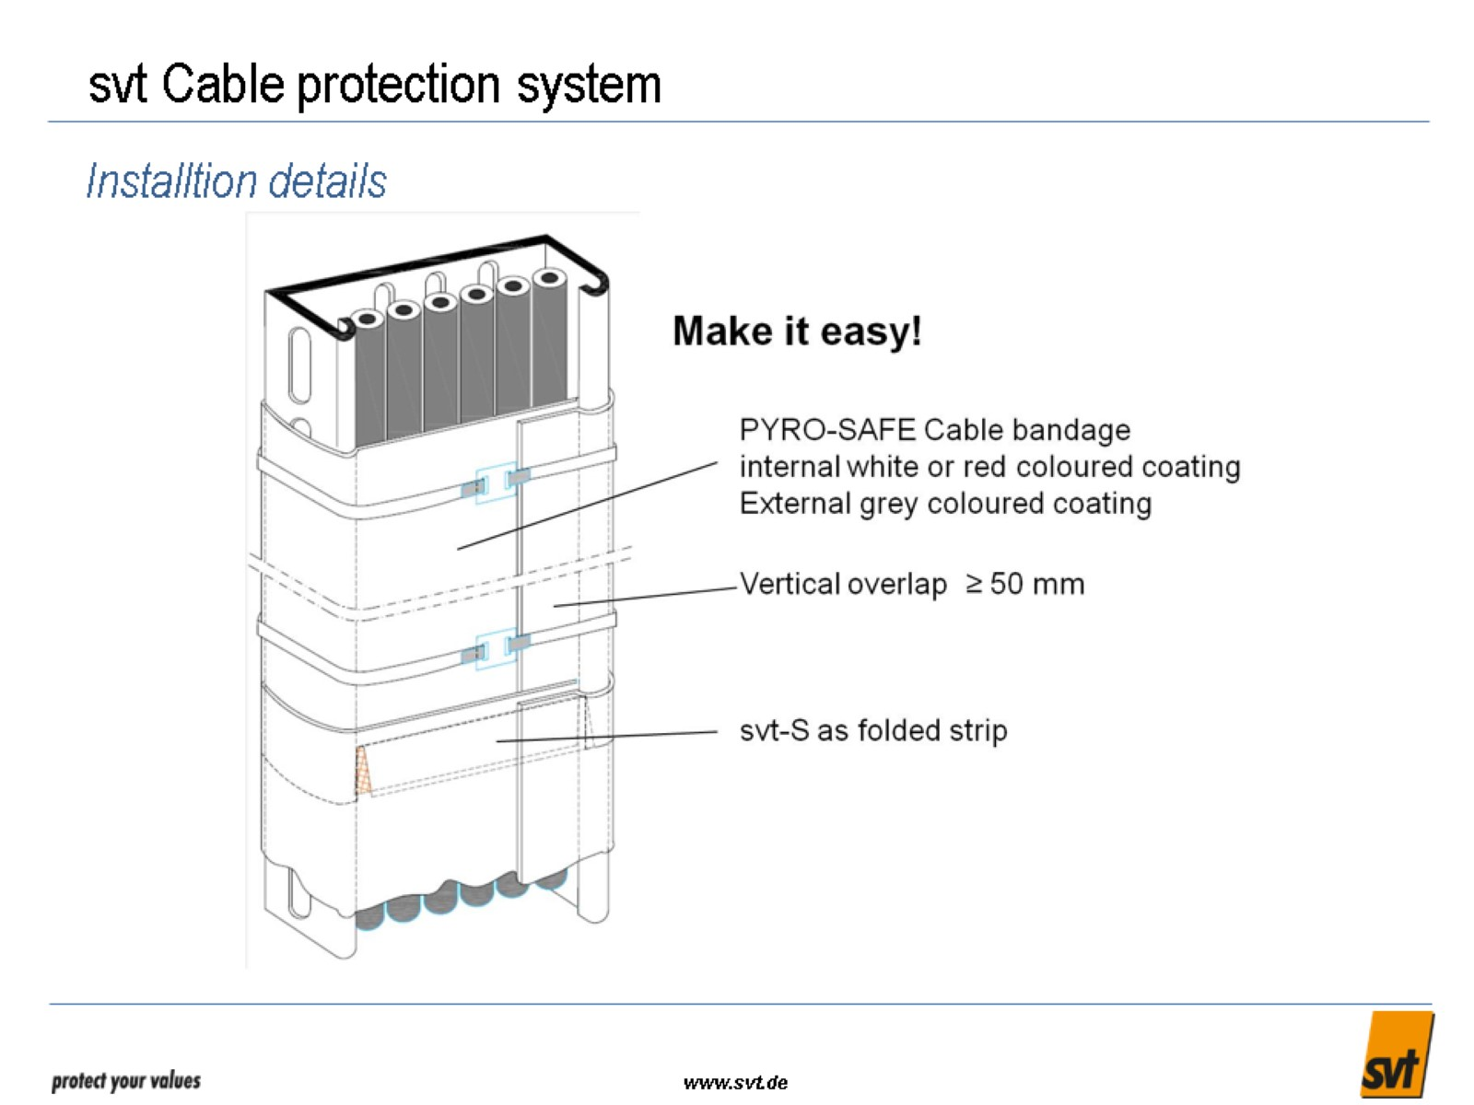
svt Cable protection system

Slide 37
svt PYRO-SAFE ® cable protection

Slide 38
svt PYRO-SAFE ® cable protection system

Slide 39
References

Slide 40
References

Slide 41
References

Slide 42
References

Slide 43
References

Slide 44
References

Slide 45
References

Slide 46
References

Slide 47
References

Slide 48
References

Slide 49
References

Slide 50
References

Slide 51
References

Slide 52
References

Slide 53
References

Slide 54
References

Slide 55
References

Slide 56
References

Slide 57
References

Slide 58
References

Slide 59
References

Slide 60
References

Slide 61
References

Slide 62
References

Slide 63
References

Slide 64
References

Slide 65
References

Slide 66
References

Slide 67
References

Slide 71
References 1- SSEM SUBSTATIONS KSA - HENDAWYAH 110KV - AIRPORT 380 KH AND MANY SUBSTATIONS 2- Holiday in makkah azizyah. Client : makkah real estate co. 3- Dubah Green Power Plant.

Slide 74
References

